Slide 1
Exploratory Data Analysis (EDA) Data Cleaning & Visualization
Week 2

Slide 2
What is EDA?
Definition: "Exploratory Data Analysis is the process of understanding your data before formal analysis"
Three Main Goals:
Discover patterns and relationships
Identify anomalies and issues
Generate hypotheses for testing

Slide 3
The EDA Philosophy
Be a Detective, Not a Judge:
Ask Questions: "Why does this pattern exist?“
Document Everything: Every observation counts
Stay Curious: Assume nothing, question everything
Visualize Early: See what the numbers can't show

Slide 4
The Complete EDA Workflow
1. LOAD → Get your data
2. INSPECT → First impressions
3. CLEAN → Fix problems
4. EXPLORE → Find patterns
5. VISUALIZE → See insights
6. DOCUMENT → Record everything
Time Allocation:
Cleaning: 40%
Visualization: 30%
Exploration: 20%
Documentation: 10%

Slide 5
Python's EDA Stack
Essential Libraries:
# Data Manipulation
import pandas as pd
# Numerical Operations
import numpy as np
# Basic Plotting
import matplotlib.pyplot as plt
# Statistical Visualization
import seaborn as sns
# Missing Data Visualization
!pip install missingno --- we use pip install command to install new library
import missingno as msno

Slide 6
Meet Our Dataset: Titanic
Real Historical Data:
891 passengers on RMS Titanic
Survival records from 1912
12 features per passenger
Why This Dataset?
Clean but realistic
Clear business questions
Mix of data types
Well-documented

Slide 7
Loading Data in Python
From URL (Easiest):
import pandas as pd
url = "https://raw.githubusercontent.com/datasciencedojo/datasets/master/titanic.csv"
titanic = pd.read_csv(url)
From Local File:
titanic = pd.read_csv('titanic.csv')
Output Check:
print(f"Rows: {titanic.shape[0]}, Columns: {titanic.shape[1]}")

Slide 8
First look at the Data
Quick Inspection Commands:
titanic.head() # First 5 rows
titanic.tail() # Last 5 rows
titanic.shape # (891, 12)
titanic.columns # Column names
titanic.dtypes # Data types
titanic.info() # Detailed overview

Slide 9
Understanding Data Types
Common Types & Their Uses:
Type | Examples | What to Do
int64 | Age, Pclass | Calculate statistics
float64 | Fare, Age | Numerical analysis
object | Name, Sex | Text processing
bool | Survived | Count proportions
category | Embarked | Group operations

Slide 10
Missing Data - The Reality Check
Check for Missing Values:
missing = titanic.isnull().sum()
missing_pct = (missing / len(titanic)) * 100
missing_df = pd.DataFrame({
'Missing Values': missing,
'Percentage': missing_pct
})
print(missing_df[missing_df['Missing Values'] > 0])
Titanic's Missing Data:
Age: 177 (19.9%)
Cabin: 687 (77.1%)
Embarked: 2 (0.2%)

Slide 11
Visualizing Missing Data
Matrix View:
msno.matrix(titanic)
plt.title("Missing Data Pattern")
plt.show()
Bar Chart:
msno.bar(titanic)
plt.title("Missing Values by Column")
plt.show()

Slide 12
Data Cleaning Strategy
Decision Tree for Missing Data:
Is >70% missing? → DROP column
Is 30-70% missing? → IMPUTE with care
Is <30% missing? → IMPUTE reasonably
Is <5% missing? → IMPUTE or DROP few rows

Slide 13
Step 1 - Drop Problematic Columns
Cabin has 77% missing → Drop it:
titanic_clean = titanic.drop(columns=['Cabin'])
print(f"After dropping Cabin: {titanic_clean.shape}")
Why Drop?
Too many missing values
Hard to impute meaningfully
Not critical for analysis

Slide 14
Step 2 - Impute Age Smartly
Age has 20% missing → Impute by class:
# Calculate median age by passenger class
age_by_class = titanic_clean.groupby('Pclass')['Age'].median()
print(age_by_class)
Apply imputation:
titanic_clean['Age'] = titanic_clean.groupby('Pclass')['Age'].apply(
lambda x: x.fillna(x.median())
)
print(f"Missing Age now: {titanic_clean['Age'].isnull().sum()}")

Slide 15
Step 3 - Fix Remaining Issues
Embarked (only 2 missing):
# Find most common value
most_common = titanic_clean['Embarked'].mode()[0]
print(f"Most common embarkation: {most_common}")
# Fill missing values
titanic_clean['Embarked'] = titanic_clean['Embarked'].fillna(most_common)
Verify cleaning:
print("Missing values after cleaning:")
print(titanic_clean.isnull().sum().sum()) # Should be 0

Slide 16
Optimize Data Types
Memory Optimization:
# Before conversion
print(f"Memory before: {titanic_clean.memory_usage(deep=True).sum() / 1024**2:.2f} MB")
# Convert to efficient types
titanic_clean['Sex'] = titanic_clean['Sex'].astype('category')
titanic_clean['Embarked'] = titanic_clean['Embarked'].astype('category')
titanic_clean['Survived'] = titanic_clean['Survived'].astype('bool')
# After conversion
print(f"Memory after: {titanic_clean.memory_usage(deep=True).sum() / 1024**2:.2f} MB")
print(f"Saved: {(1 - (after/before)) * 100:.1f}% memory")

Slide 17
Summary Statistics
The .describe() Method:
print(titanic_clean.describe())
Output shows:
Count: Number of non-null values
Mean: Average
Std: Standard deviation
Min/Max: Range
25%, 50%, 75%: Quartiles

Slide 18
Univariate Analysis - What Is It?
Analyzing Single Variables:
For Numeric Variables:
Distribution shape
Central tendency (mean, median)
Spread (variance, range)
Outliers
For Categorical Variables:
Frequency counts
Proportions
Most common values

Slide 19
Analyzing Age Distribution
Histogram:
plt.figure(figsize=(10, 6))
plt.hist(titanic_clean['Age'], bins=30, edgecolor='black', alpha=0.7)
plt.title('Age Distribution of Titanic Passengers')
plt.xlabel('Age')
plt.ylabel('Count')
plt.grid(True, alpha=0.3)
plt.show()
Insights:
Most passengers: 20-40 years
Few children (<10)
Few elderly (>60)

Slide 20
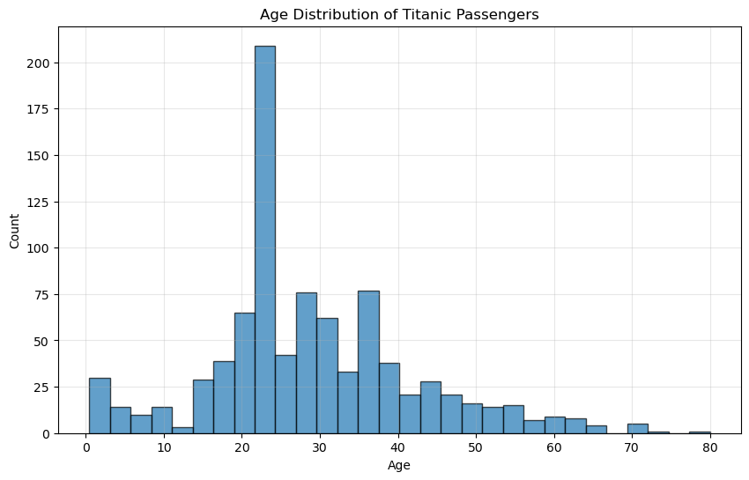

Slide 21
Analyzing Fare Distribution
Box Plot for Outliers:
plt.figure(figsize=(8, 6))
titanic_clean['Fare'].plot(kind='box')
plt.title('Fare Distribution with Outliers')
plt.ylabel('Fare (USD)')
plt.show()
Histogram (Log Scale):
plt.figure(figsize=(10, 6))
plt.hist(titanic_clean['Fare'], bins=50, edgecolor='black', alpha=0.7, log=True)
plt.title('Fare Distribution (Log Scale)')
plt.xlabel('Fare')
plt.ylabel('Count (Log Scale)')
plt.show()

Slide 22
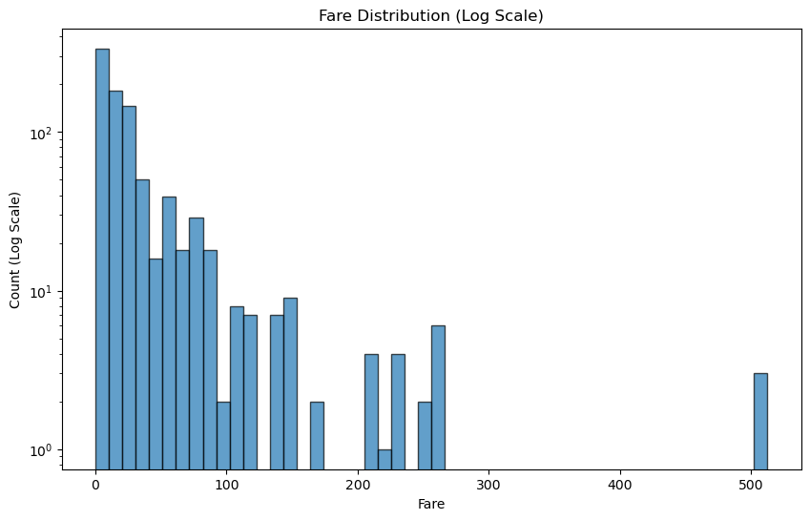

Slide 23
Categorical Analysis: Passenger Class
Bar Chart:
class_counts = titanic_clean['Pclass'].value_counts().sort_index()
plt.figure(figsize=(8, 6))
class_counts.plot(kind='bar', color=['gold', 'silver', 'brown'])
plt.title('Passenger Distribution by Class')
plt.xlabel('Class (1=First, 3=Third)')
plt.ylabel('Number of Passengers')
plt.xticks(rotation=0)
plt.show()
Proportions:
First Class: 24%
Second Class: 21%
Third Class: 55%

Slide 24
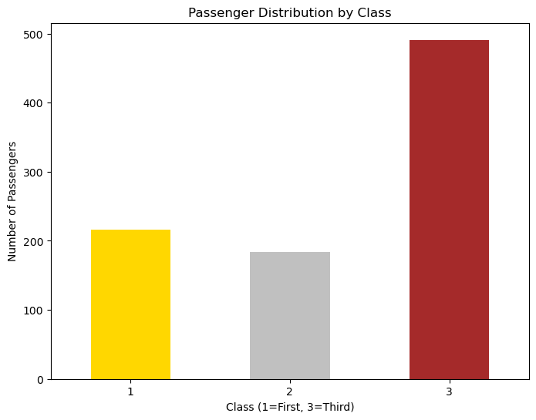

Slide 25
Categorical Analysis: Gender
Simple Bar Chart:
gender_counts = titanic_clean['Sex'].value_counts()
plt.figure(figsize=(8, 6))
gender_counts.plot(kind='bar', color=['lightblue', 'pink'])
plt.title('Gender Distribution')
plt.xlabel('Gender')
plt.ylabel('Count')
plt.show()
Statistics:
Male: 577 (65%)
Female: 314 (35%)
Ratio: ~2:1 male to female

Slide 26
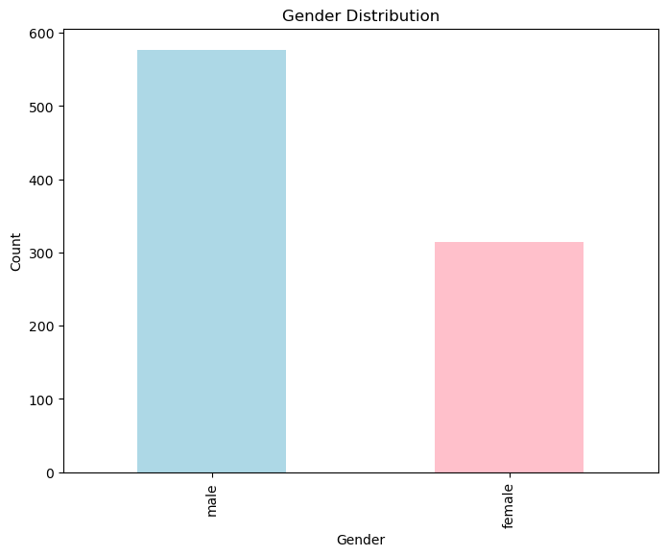

Slide 27
Bivariate Analysis - Understanding Relationships
Three Types of Relationships:
Numeric vs Numeric
Scatter plots
Correlation coefficients
Numeric vs Categorical
Box plots
Violin plots
Categorical vs Categorical
Stacked bar charts
Heatmaps

Slide 28
Age vs Fare Scatter Plot
Basic Scatter:
plt.figure(figsize=(10, 6))
plt.scatter(titanic_clean['Age'], titanic_clean['Fare'], alpha=0.5)
plt.title('Age vs Fare Paid')
plt.xlabel('Age')
plt.ylabel('Fare (USD)')
plt.grid(True, alpha=0.3)
plt.show()
Insights:
Older passengers paid more
Children (under 10) had lower fares
Some very high fares regardless of age

Slide 29
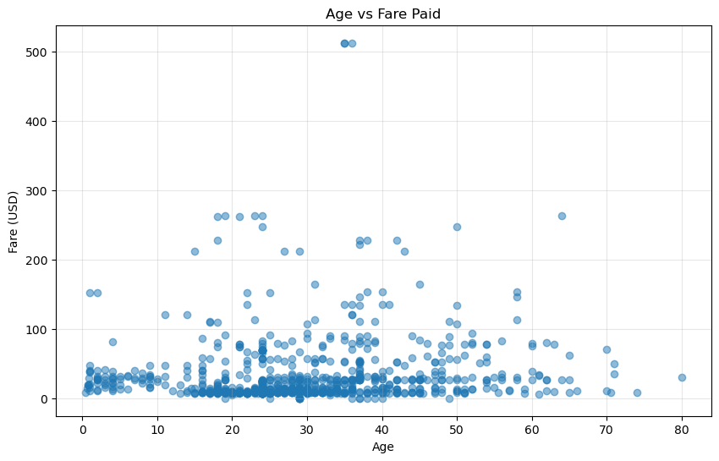

Slide 30
Survival by Gender
The Most Dramatic Pattern:
survival_by_gender = titanic_clean.groupby('Sex')['Survived'].mean()
plt.figure(figsize=(8, 6))
survival_by_gender.plot(kind='bar', color=['pink', 'lightblue'])
plt.title('Survival Rate by Gender')
plt.xlabel('Gender')
plt.ylabel('Survival Rate')
plt.ylim(0, 1)
plt.show()
The Numbers:
Female: 74% survived
Male: 19% survived
Difference: 55 percentage points

Slide 31
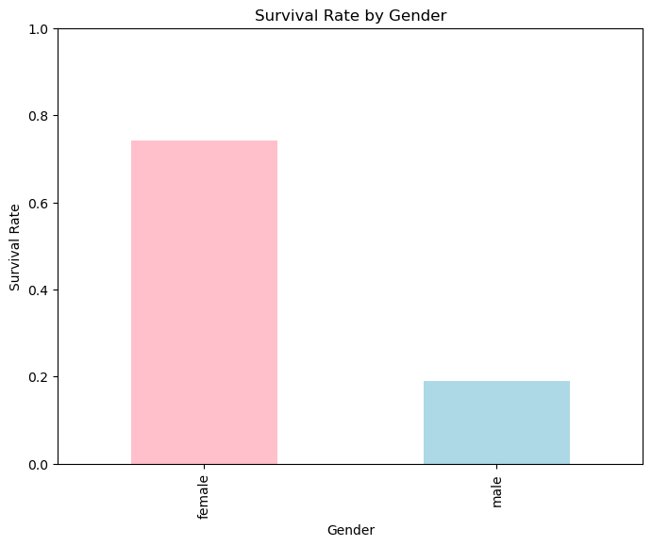

Slide 32
Survival by Passenger Class
survival_by_class = titanic_clean.groupby('Pclass')['Survived'].mean()
plt.figure(figsize=(8, 6))
survival_by_class.plot(kind='bar', color=['gold', 'silver', 'brown'])
plt.title('Survival Rate by Passenger Class')
plt.xlabel('Class')
plt.ylabel('Survival Rate')
plt.ylim(0, 1)
plt.show()
Survival Rates:
First Class: 63%
Second Class: 47%
Third Class: 24%

Slide 33
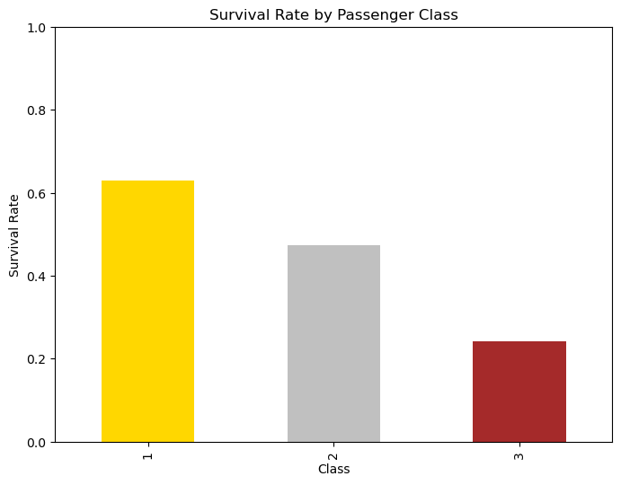

Slide 34
Enhanced Scatter Plot
Color by Survival, Size by Class:
plt.figure(figsize=(12, 8))
scatter = plt.scatter(
titanic_clean['Age'],
titanic_clean['Fare'],
c=titanic_clean['Survived'],
s=titanic_clean['Pclass'] * 50, # Size by class
alpha=0.6,
cmap='coolwarm'
)
plt.colorbar(scatter, label='Survived (0=No, 1=Yes)')
plt.title('Age vs Fare (Colored by Survival, Sized by Class)')
plt.xlabel('Age')
plt.ylabel('Fare (USD)')
plt.grid(True, alpha=0.3)
plt.show()

Slide 35
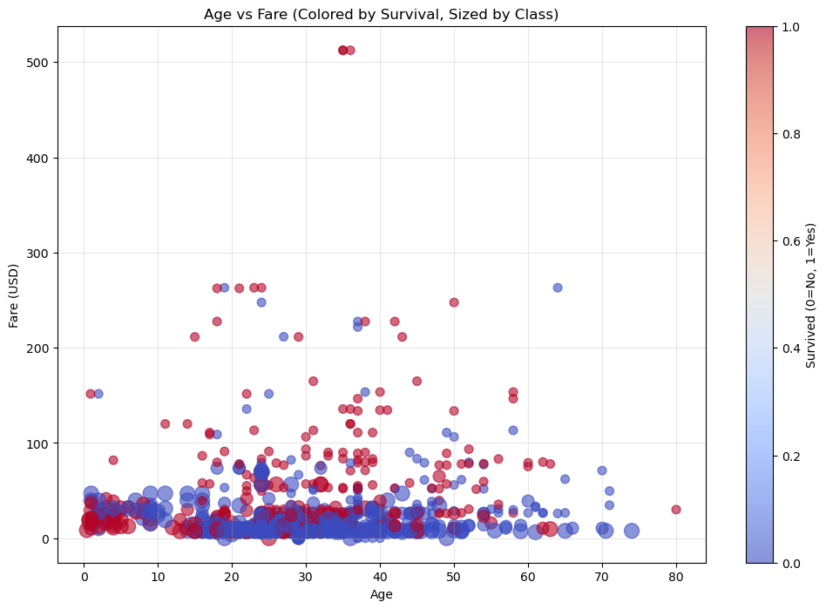

Slide 36
Correlation Heatmap
Finding Relationships Between Numbers:
# Select only numeric columns
numeric_cols = titanic_clean.select_dtypes(include=[np.number])
# Calculate correlation matrix
corr_matrix = numeric_cols.corr()
# Create heatmap
plt.figure(figsize=(10, 8))
sns.heatmap(corr_matrix,
annot=True,
cmap='coolwarm',
center=0,
square=True,
fmt='.2f',
linewidths=0.5)
plt.title('Correlation Heatmap of Titanic Dataset')
plt.show()

Slide 37
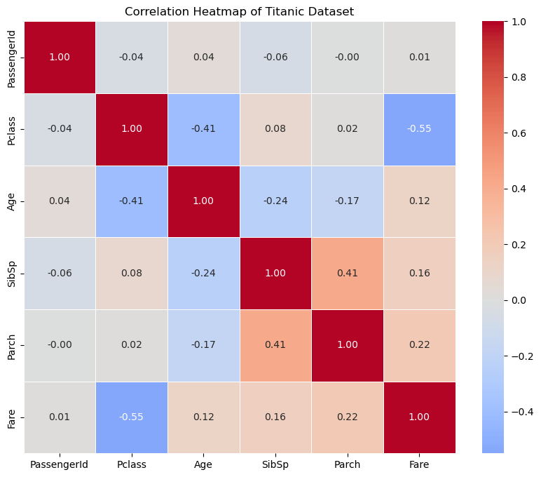

Slide 38
Creating Age Groups
Binning Continuous Data:
# Create age categories
bins = [0, 12, 18, 35, 60, 100]
labels = ['Child', 'Teen', 'Young Adult', 'Adult', 'Senior']
titanic_clean['AgeGroup'] = pd.cut(
titanic_clean['Age'],
bins=bins,
labels=labels,
right=False )
print(titanic_clean['AgeGroup'].value_counts().sort_index())

Slide 39
Survival by Age Group
Bar Chart:
survival_by_agegroup = titanic_clean.groupby('AgeGroup')['Survived'].mean()
plt.figure(figsize=(10, 6))
survival_by_agegroup.plot(kind='bar')
plt.title('Survival Rate by Age Group')
plt.xlabel('Age Group')
plt.ylabel('Survival Rate')
plt.ylim(0, 1)
plt.grid(True, axis='y', alpha=0.3)
plt.show()
"Children First" Protocol:
Children: 59% survived
Teens: 40% survived
Adults: 38% survived

Slide 40
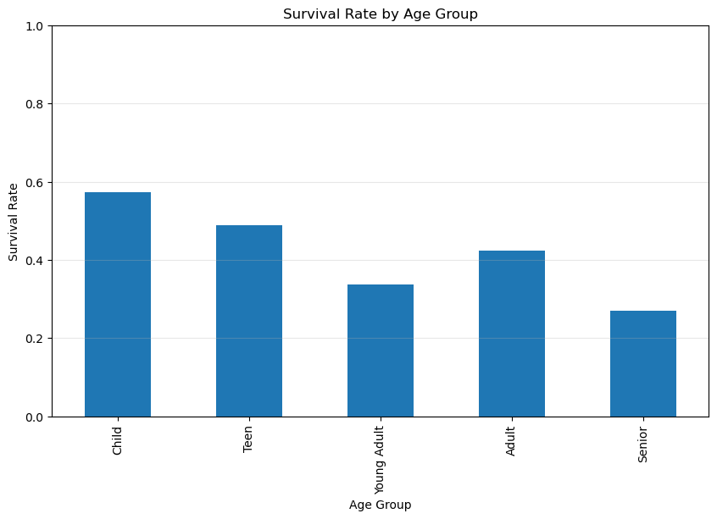

Slide 41
Family Size Analysis
Create New Features:
# Family size = siblings + parents + self
titanic_clean['FamilySize'] = (
titanic_clean['SibSp'] +
titanic_clean['Parch'] +
1 # Self
)
titanic_clean['IsAlone'] = titanic_clean['FamilySize'] == 1
print(f"Traveling alone: {titanic_clean['IsAlone'].mean() * 100:.1f}%")

Slide 42
Survival by Family Size
Line Plot:
survival_by_family = titanic_clean.groupby('FamilySize')['Survived'].mean()
plt.figure(figsize=(10, 6))
survival_by_family.plot(kind='line', marker='o')
plt.title('Survival Rate by Family Size')
plt.xlabel('Family Size')
plt.ylabel('Survival Rate')
plt.ylim(0, 1)
plt.grid(True, alpha=0.3)
plt.show()
Interesting Pattern:
Small families (2-4) survived most
Singles and very large families survived less

Slide 43
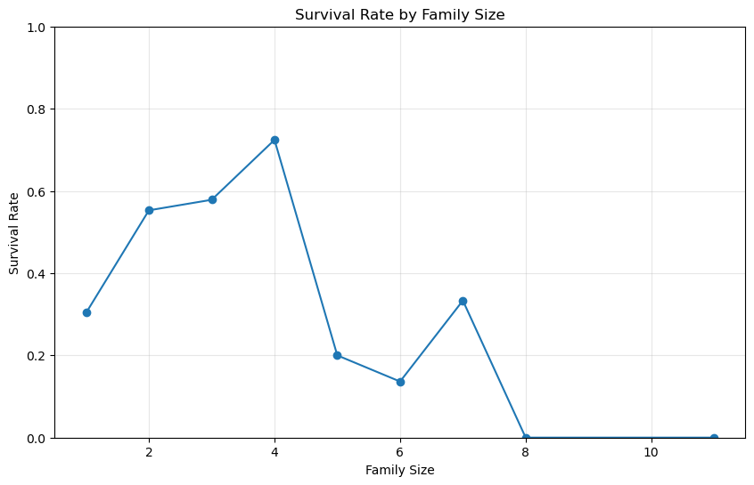

Slide 44
Advanced Visualization: Pair Plot
See All Relationships at Once:
# Select key columns
columns_to_plot = ['Age', 'Fare', 'Pclass', 'Survived']
# Create pair plot
sns.pairplot(
titanic_clean[columns_to_plot],
hue='Survived',
diag_kind='kde',
plot_kws={'alpha': 0.6}
)
plt.suptitle('Pair Plot: Relationships Between Key Variables', y=1.02)
plt.show()

Slide 45
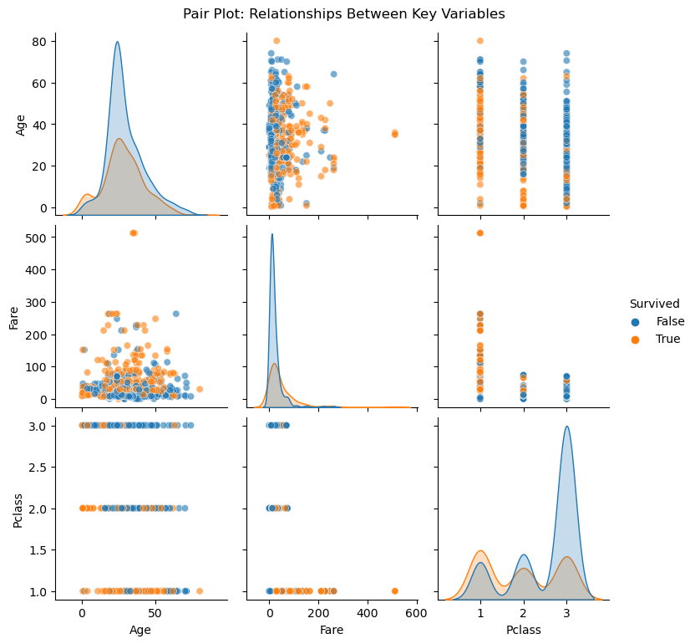

Slide 46
Violin Plot - Age by Class & Survival
Rich Distribution View:
plt.figure(figsize=(12, 8))
sns.violinplot(
x='Pclass',
y='Age',
hue='Survived',
data=titanic_clean,
split=True,
palette={0: 'red', 1: 'green'}
)
plt.title('Age Distribution by Passenger Class and Survival')
plt.xlabel('Passenger Class')
plt.ylabel('Age')
plt.legend(title='Survived')
plt.show()

Slide 47
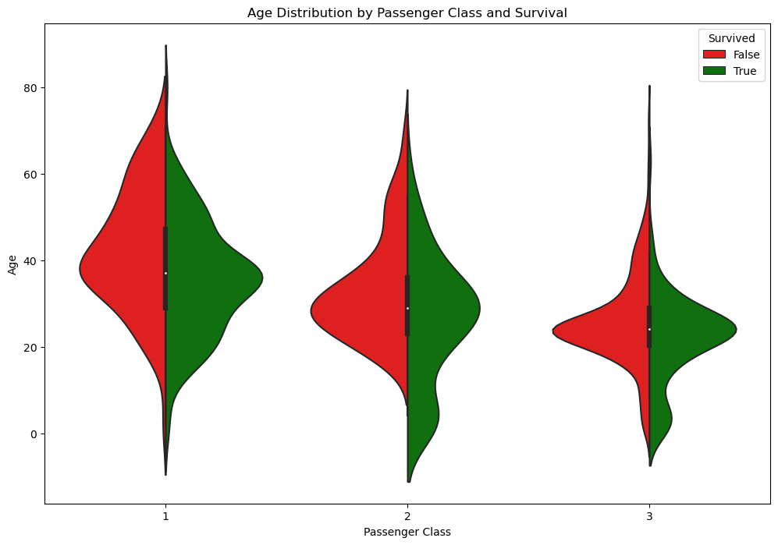

Slide 48
Facet Grid - Multi-dimensional View
# Create a grid of scatter plots
g = sns.FacetGrid(
titanic_clean,
col='Sex',
row='Pclass',
hue='Survived',
height=4,
aspect=1.2
)
g.map(sns.scatterplot, 'Age', 'Fare', alpha=0.6)
g.add_legend()
g.fig.suptitle('Age vs Fare by Gender and Class', y=1.02)
plt.show()

Slide 49
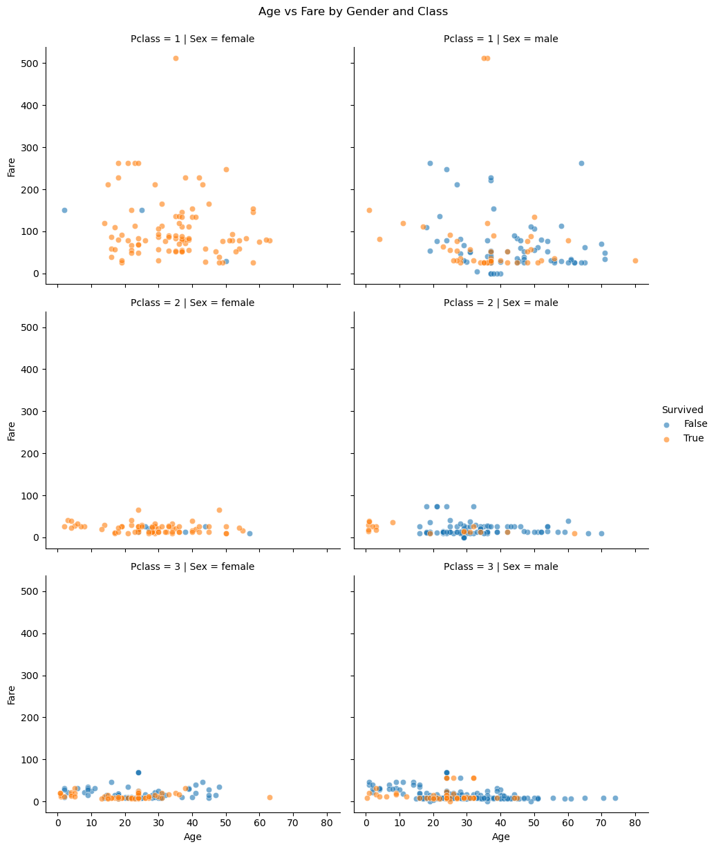

Slide 50
Outlier Detection
Q1 = titanic_clean['Fare'].quantile(0.25)
Q3 = titanic_clean['Fare'].quantile(0.75)
IQR = Q3 - Q1
lower_bound = Q1 - 1.5 * IQR
upper_bound = Q3 + 1.5 * IQR
outliers = titanic_clean[
(titanic_clean['Fare'] < lower_bound) |
(titanic_clean['Fare'] > upper_bound)
]
print(f"Outliers found: {len(outliers)}")
print(f"Percentage: {len(outliers)/len(titanic_clean)*100:.1f}%")

Slide 51
Handling Outliers - Options
Three Strategies:
Keep Them:
If they're valid data points
If they contain important information
Remove Them:
If they're data errors
If they misrepresent the analysis too much
Transform Them:
Log transformation

Slide 52
Log Transformation
For Right-Skewed Data:
# Before transformation
plt.figure(figsize=(12, 5))
plt.subplot(1, 2, 1)
plt.hist(titanic_clean['Fare'], bins=50, edgecolor='black')
plt.title('Original Fare Distribution')
plt.xlabel('Fare')
# After transformation
plt.subplot(1, 2, 2)
titanic_clean['Fare_log'] = np.log1p(titanic_clean['Fare'])
plt.hist(titanic_clean['Fare_log'], bins=50, edgecolor='black')
plt.title('Log-Transformed Fare Distribution')
plt.xlabel('Log(Fare + 1)')
plt.tight_layout()
plt.show()

Slide 53
Feature Engineering - Extract Titles
From Names to Social Status:
# Extract title from name (e.g., "Mr.", "Mrs.", "Dr.")
titanic_clean['Title'] = titanic_clean['Name'].str.extract(' ([A-Za-z]+)\.', expand=False)
# See most common titles
title_counts = titanic_clean['Title'].value_counts()
print("Most common titles:")
print(title_counts.head(10))
Common Titles:
Mr: 517
Miss: 182
Mrs: 125
Master: 40

Slide 54
Survival by Title
Social Status Matters:
# Calculate survival by title
survival_by_title = titanic_clean.groupby('Title')['Survived'].mean().sort_values()
# Plot top 10
plt.figure(figsize=(12, 6))
survival_by_title.tail(10).plot(kind='barh')
plt.title('Survival Rate by Title (Top 10)')
plt.xlabel('Survival Rate')
plt.xlim(0, 1)
plt.grid(True, axis='x', alpha=0.3)
plt.show()
Insights:
"Master" (boys): 57% survived
"Miss" (unmarried women): 70% survived
"Mrs" (married women): 79% survived
"Mr" (men): 16% survived

Slide 55
Automated EDA with pandas-profiling
One-Click Analysis:
# Install: !pip install pandas-profiling
from pandas_profiling import ProfileReport
# Generate comprehensive report
profile = ProfileReport(
titanic_clean,
title="Titanic Dataset EDA Report",
explorative=True
)
# Save to HTML
profile.to_file("titanic_eda_report.html")
# Display in notebook
# profile.to_notebook_iframe()
Features:
Automatic correlation detection
Missing values analysis
Distribution plots
Data type detection
Warnings and alerts

Slide 56
Interactive EDA with D-Tale library
Browser-Based Exploration:
# Install: !pip install dtale
import dtale
# Launch interactive app
d = dtale.show(titanic_clean)
# Open in browser
d.open_browser()
Capabilities:
Filter and sort data
Create visualizations
Check correlations
Export code for operations
Statistical summaries

Slide 57
Key Titanic Insights
Summary of Findings:
Gender Gap: Women survived more than men
Class Divide: 1st class survived more than 3rd class
Age Priority: Children had highest priority
Family Effect: Medium families (2-4) survived most
Price of Safety: Higher fare correlated with survival

Slide 58
Common EDA Mistakes
Avoid These Pitfalls:
Not checking data types → Wrong analysis
Ignoring missing values → Biased results
Removing outliers blindly → Losing signal
Skipping univariate analysis → Missing basics
Not documenting → Can't reproduce
Over-plotting → Confusion

Slide 59
Visualization Best Practices
The Right Chart for the Right Question:
Question | Best Chart
Distribution? | Histogram, Box plot
Comparison? | Bar chart, Column chart
Relationship? | Scatter plot, Heatmap
Composition? | Stacked bar, Pie chart
Trend over time? | Line chart
Always:
Label axes clearly
Add informative titles
Use consistent colors
Avoid chart junk

Slide 60
Thank You & Good Luck!

